Slide 1
Welcome to the P&M Technical Session
Dr. Joshua Piehl Mechanical Engineer, US Army DEVCOM – GVSC
Thomas Trzaska Director, Strategic Technology, RENK America (Retired)
Porfirio Nogueiro Technical Fellow, BAE Systems
Isaac Rife Program Engineering Manager, BAE Systems
Dr. Eric Gingrich Specialist Research Engineer, US ARMY DEVCOM - GVSC

Slide 2

Published Paper Access
Use the link or scan the QR code below for access to today’s published papers.
- Papers can be found next in the agenda next to their respective session
Papers will be available through SAE in September.
https://www.ndia-mich.org/gvsets/agenda

Slide 3

GVSETS Technical Paper Archive
https://saemobilus.sae.org/
Search “ndia”

Slide 4
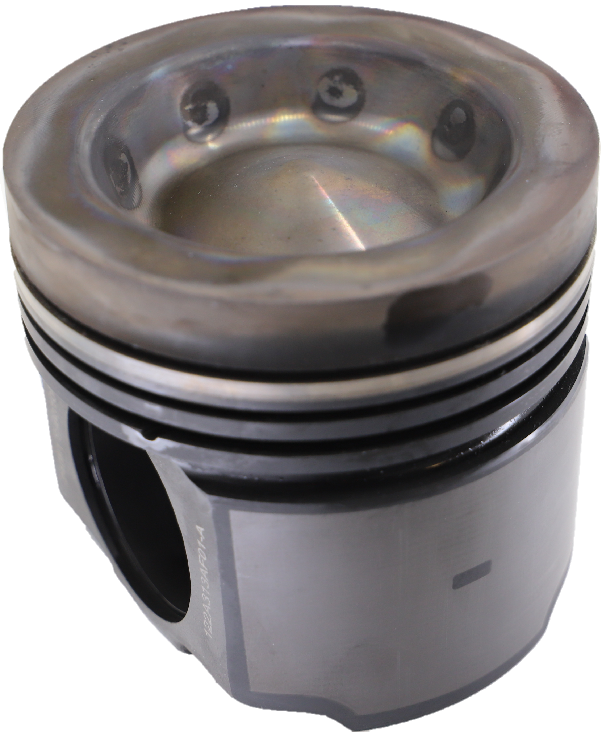
10:20 AM
Initial Thermal Evaluation of 422 Martensitic Stainless Steel Piston in a High-output Diesel Engine
Dr. Eric Gingrich
Dr. Michael Tess
Arkady Grunin
Dr. Vamshi Korivi
Dr. Katie Sebeck
Dr. Dean Pierce
Dr. Yiyu Wang
Dr. Govindarajan Muralidharan
Dr. Rishi Pillai
Dr. James Haynes
Kurt Will
Gingrich et al., SAE 2022-01-0599

Slide 5

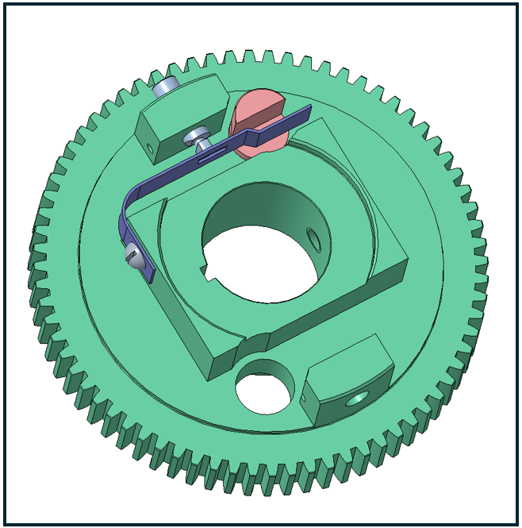
10:40 AM
Methods for Designing Rotating Components for Compliance to ISO 1940 Balance Requirements Using Generic 3D CAD Software
John Srodawa

Slide 6
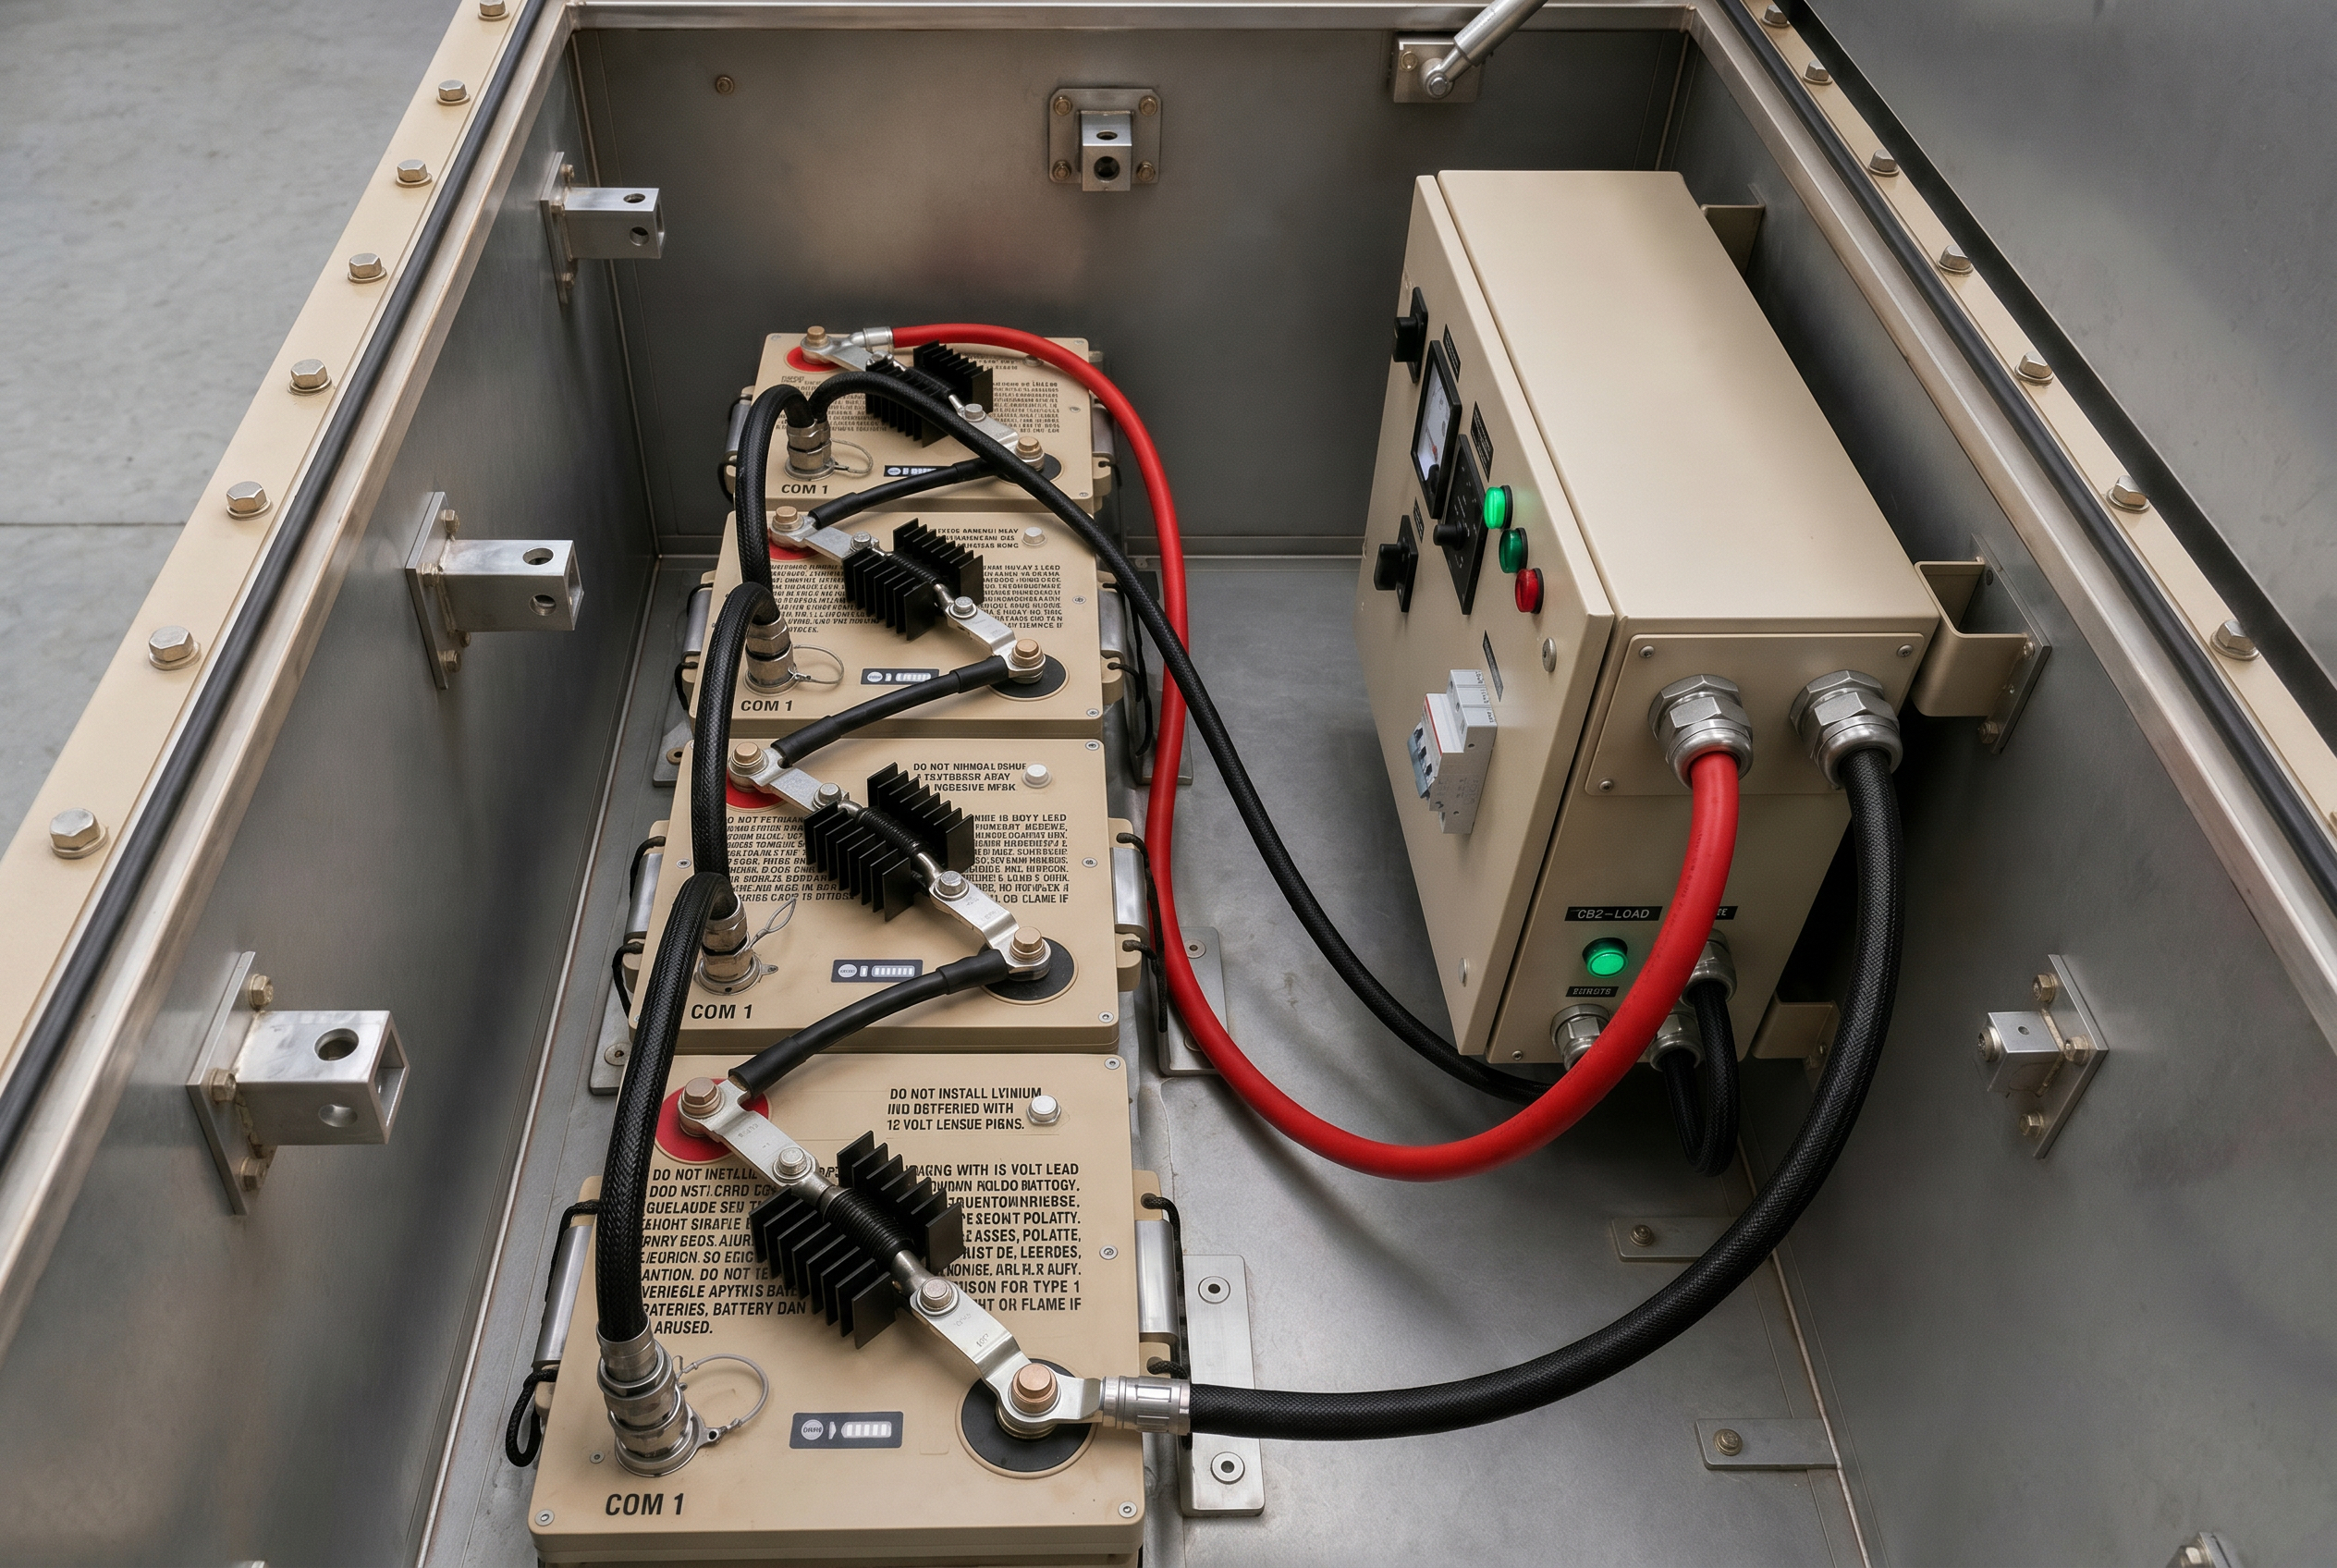
11:00 AM
Connecting Standard Li-Ion Batteries in Series to Form a High Voltage Array
Felix Frisch
Ori Kost
Michael Baab

Slide 7
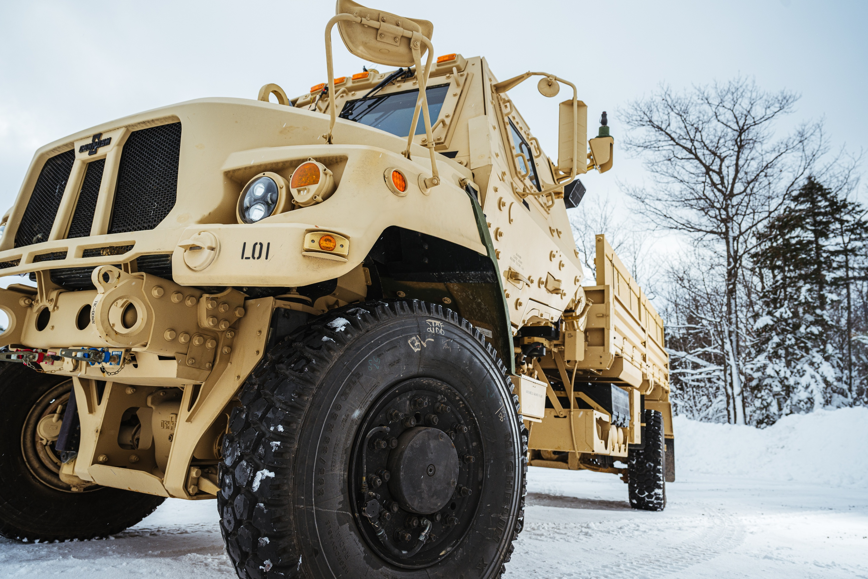
11:20 AM
Modeling the Operational Performance Impacts of a Vehicle Integrated Power Kit (VIPK) on a Medium Tactical Wheeled Vehicle
Dr. Bryant Goodenough
Henry Schmidt
Dr. Jeffery Naber
Paul Dice
David Subert
Kevin Meyers

Slide 8
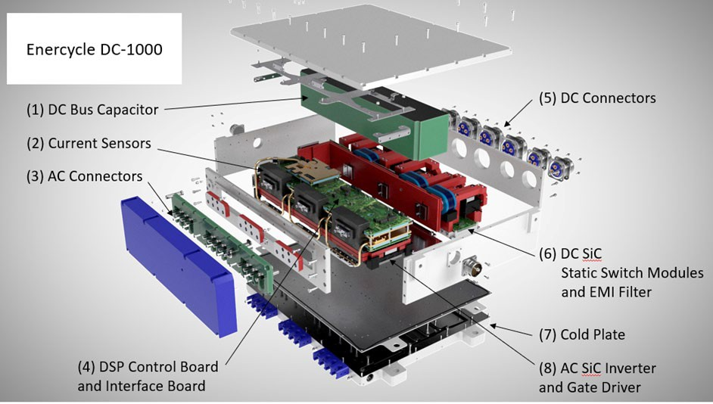
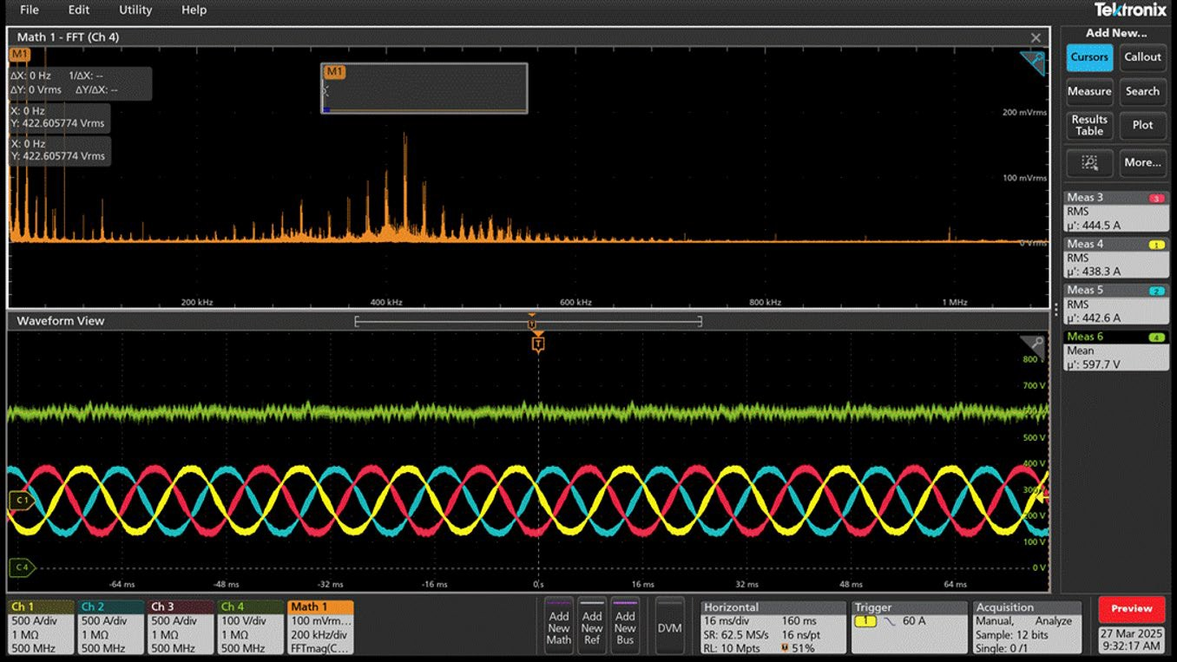
11:40 AM
Electrical and Power Quality Performance Evaluation of SiC Based 500 kW High Temperature and High Power-Density Inverter
Dr. Arash Khoshkbar Sadigh
Iris Shiroma

Slide 9
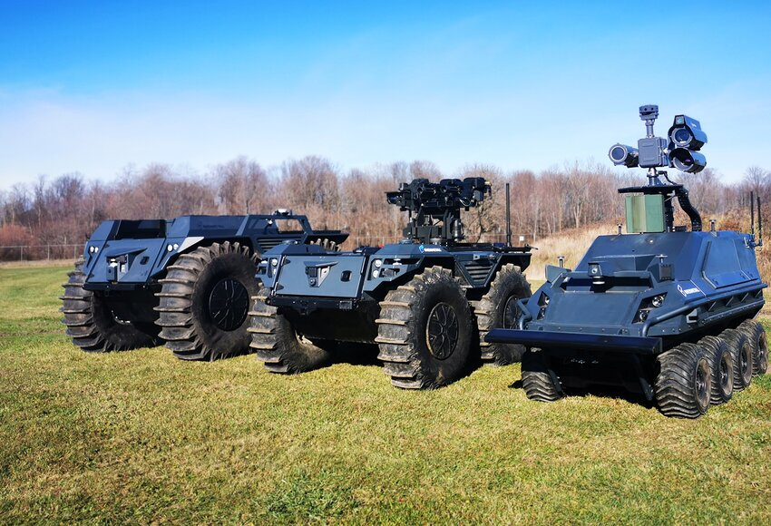
12:00 PM
Lunch & Outdoor Tech Demo: American Rheinmetall’s Ox/GOAT & MMET UGVs

Slide 10

Networking Reception
Join us for our networking reception!
5:15 – 7:15 PM
Outdoor Patio

